Slide 1
ORGANIZING THE CONTENT Information Architecture and Application structure patterns. Navigation, Signposts and wayfinding patterns

Slide 2
Post Requirements Gathering
At this point you should know what your users want out of the application.
What’s Next?
General Mental Pictures, Sketches, Mock ups?
High Level Organization is often the most difficult task in designing a user interface
So before you get into the design, separate the content from it’s physical presentation
Don’t start by thinking of things in terms of Windows, Tabs, Panels, Controls, etc.
Start by organizing actions and object abstractly

Slide 3
Order of Design Operations
1) Organization and Task Flows
Separate Actions and Objects from Presentation
2) Physical Structure
Layout Windows, Panels, Controls, etc
Difference in general web page design vs. application design?

Slide 4
Common Application Organization Approaches
Lists of Objects
Inbox, Task List, Shopping Cart, etc
Lists of Actions or Tasks
Browse, Buy, Sell, Write, Draw, etc
List of Subject Categories
Genre, Type, etc
List of Tools
Calendar, Address Book, Notepad, etc

Slide 5
Considerations for Choosing and Approach
The nature and domain of the application
Users’ domain knowledge
Users’ comfort level with technology
Comparable mental models pre-existing for users in your domain
You decision here can make or break and interface
Is it ok to mix paradigms?

Slide 6
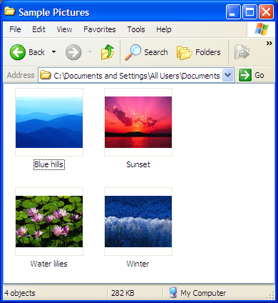
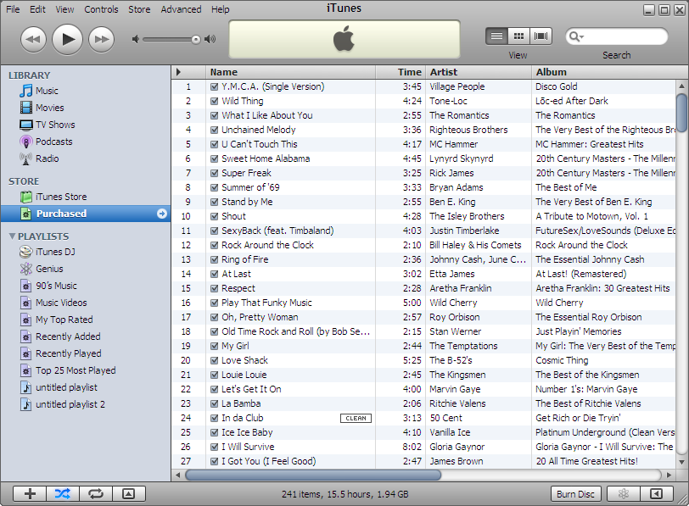
Lists of Objects

Slide 7
List of Objects
Often the most obvious user interface approach
Examples
Email, Songs, Books, Images
Search Results, Financial Transactions
Contacts, Tasks, Explorers
From these we reach familiar UI Idioms:
Forms to Edit or View things
Players or Viewers to play media
Web Pages to Print things

Slide 8
Presenting Lists of Objects
Common Models
Linear (typically sortable)
Tables (typically sortable by column and filterable)
Hierarchies
Groups items by Category
Groups items by relationship (parent/child)
Spatial (Maps, Charts, etc)
Controls
Tables, Lists, Trees, etc

Slide 9
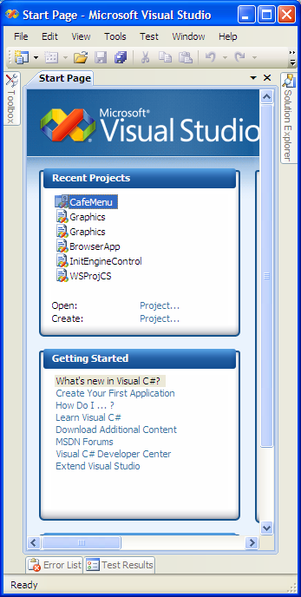
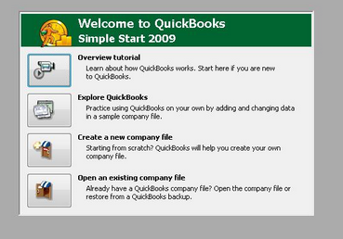
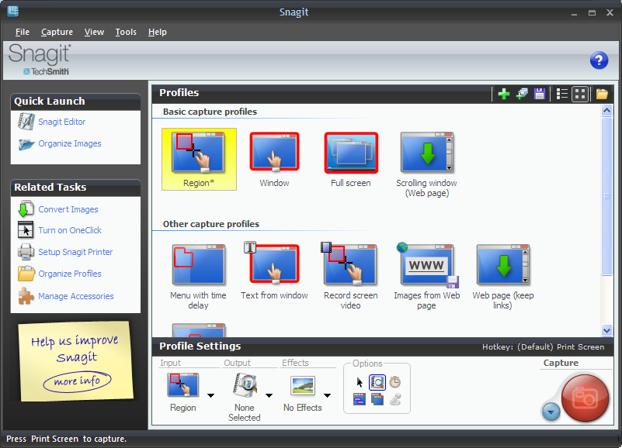
List of Actions

Slide 10
List of Actions
Verb-centered rather than noun-centered
“What do you want to do?”
“What do you want to work on?”
“What type of item would you like to create?”
Benefit is often that this type of interface is explained in plain English (plain language)
How many actions are appropriate?

Slide 11
Presenting Lists of Actions
Single Window Drilldown
Engage Selected Item’s Action
Double Click to Invoke
Other Approaches (not high level):
Buttons, Menu Bars, Pop-up Menus
Dropdown Menus, Toolbars, Links, Action Panels
Real-estate or effeciency concerns?

Slide 12
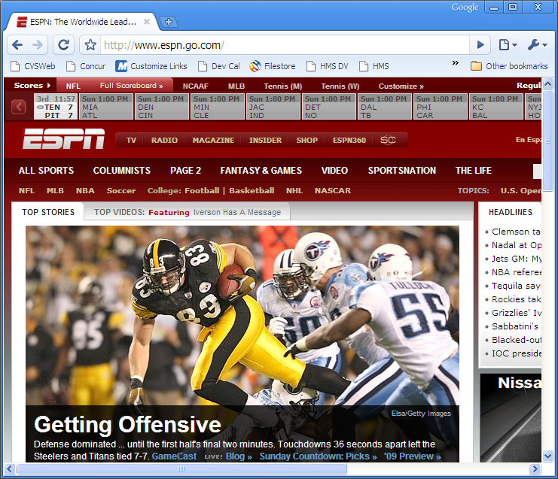
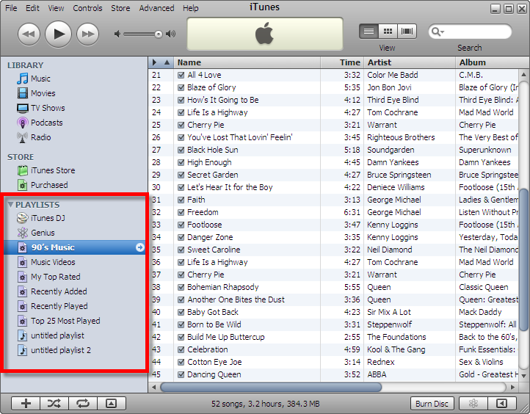
List of Categories

Slide 13
Lists of Categories
Used often in website design due to the large amount of diverse data mean for many people
Not used often in application design. Categories are better for noun oriented software rather than action oriented applications.
That doesn’t mean categories aren’t a good tool for organizing subsets of an applications presentation data

Slide 14
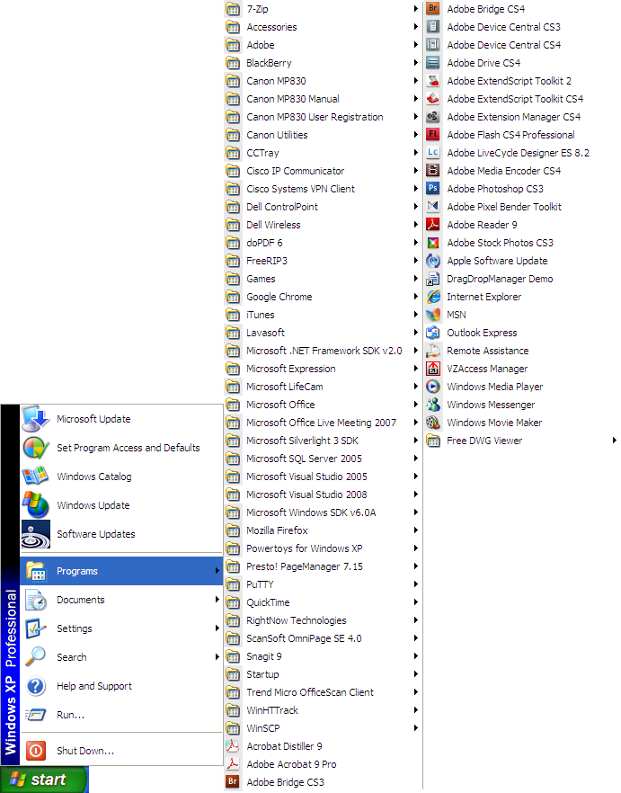
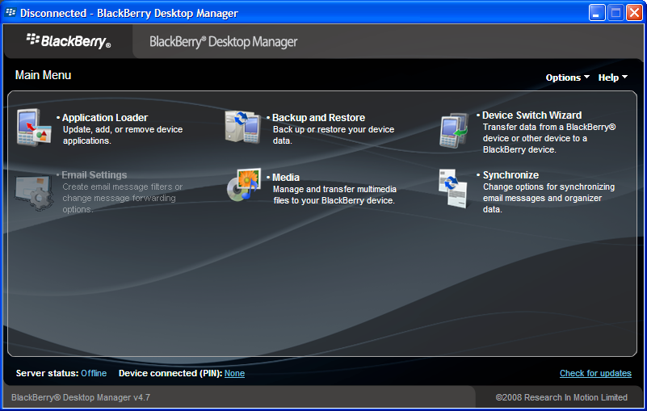
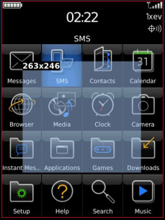
List of Tools

Slide 15
Lists of Tools
Commonly used by Operating Systems, Palm Pilots, Blackberrys, Cell Phones, etc
Some Applications use this paradigm as well: Microsoft Money, Quick Books, etc
Tool-based Organization typically fails when the names of tools mix with actions, tasks or objects – User expectations

Slide 16
Presenting Lists of Tools
Linear is most common
Flat list
Table
Sorted?
Alphabetically
By Category
By Frequency of Use
Customizable
Hub and Spoke Navigation

Slide 17
Navigation, Signposts and Wayfinding

Slide 18
Staying Found
Good Signage
Environmental Clues
Map

Slide 19
Page Depth
Keep navigation paths short (number of pages)
Avoid nested dialogs/windows
Functionality vs. Usability Tradeoffs

Slide 20
Patterns
Clear Entry Points
Global Navigation
Hub and Spoke
Pyramid
Modal Panel
Sequence Map
Breadcrumbs
Annotated Scrollbar
Color-Coded Sections
Animated Transition
Escape Hatch

Slide 21
Navigation Patterns

Slide 22

Clear Entry Points
Present a few task oriented entry points into an interface

Slide 23
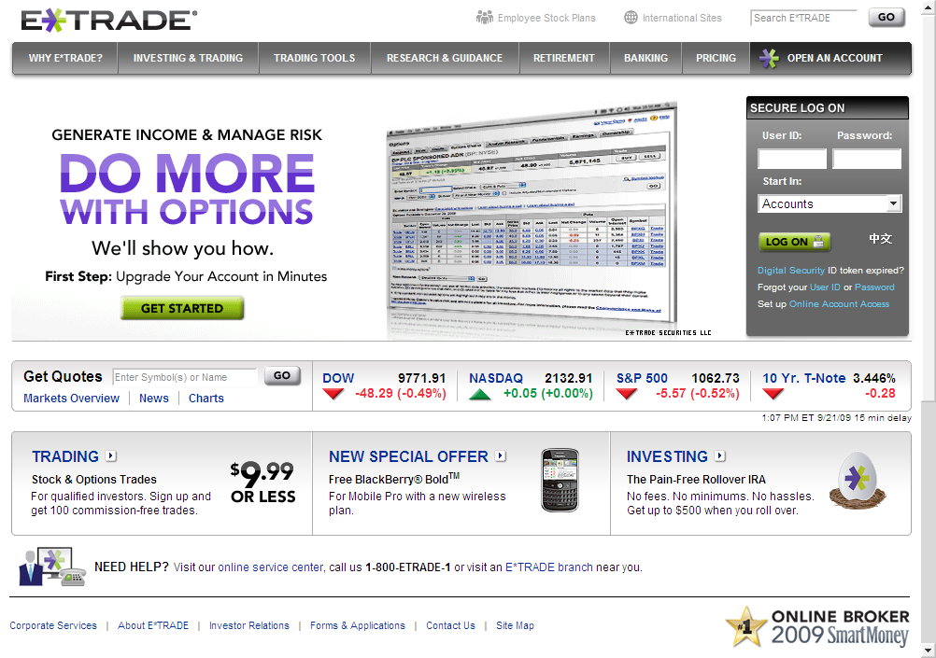
Clear Entry Points?

Slide 24
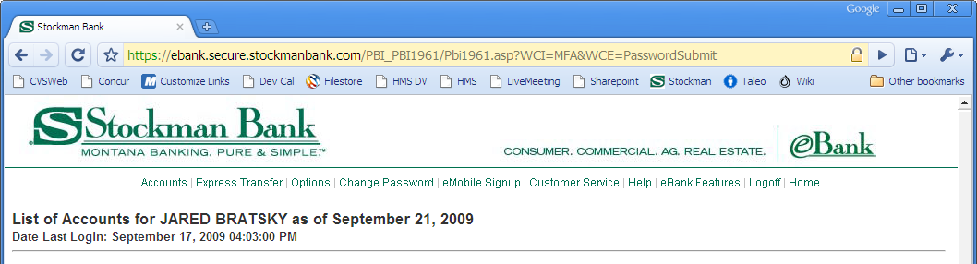
Global Navigation
Reserve a section of every page to show a consistent set of links or buttons to navigate to key sections of the application (or site)

Slide 25
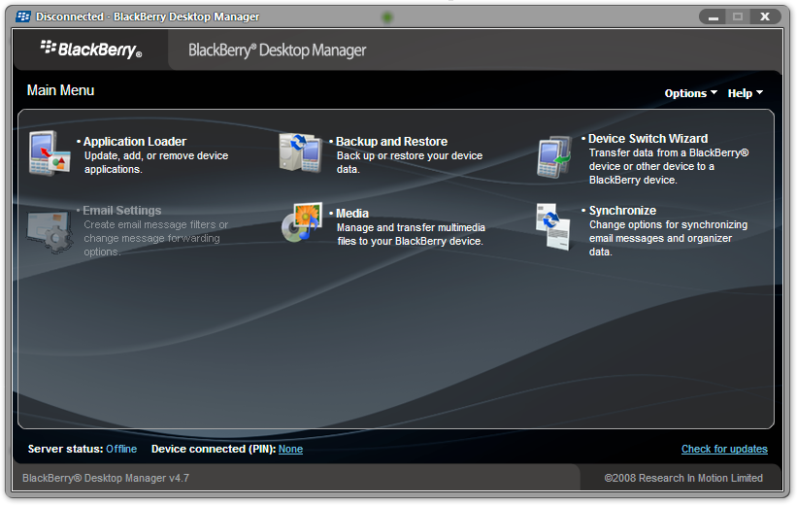
Hub and Spoke
Sub Applications reached from the main navigation page with one way in and one way out.

Slide 26
Pyramid
Linked Sequence of Pages with Previous/Back and Next links or Actions
Typically combined with a main page that has navigation links to each page individually

Slide 27
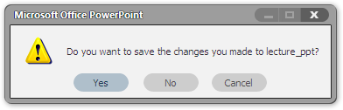
Modal Panel
Show one page with navigation options only to accomplish the immediate task

Slide 28
Signposts

Slide 29
Sequence Map
Show the full navigation map on each page with indication of current position in the sequence
Navigation: Map markers are typically clickable as a method to jump forward or backward in the sequence

Slide 30
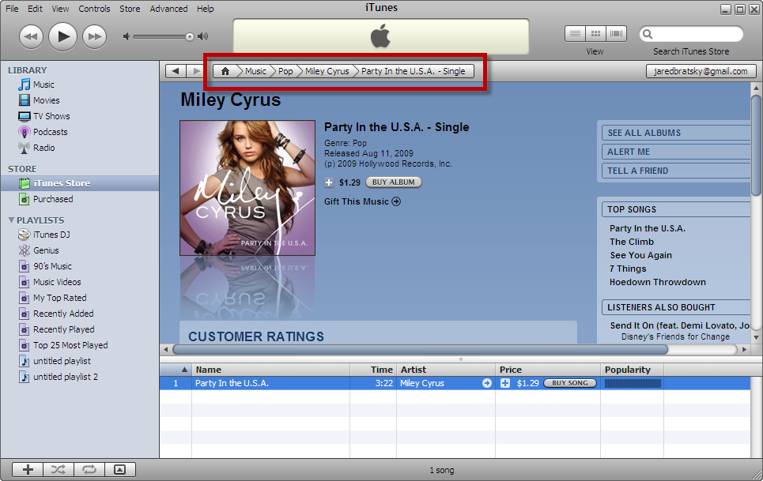
Breadcrumbs
Show a map of current and all parent/previous pages on current page
Navigation: Parent/Previous pages are typically clickable navigation links to return up the chain

Slide 31
Annotated Scrollbar
Use the scrollbar to act as a current location notification in your sequence map
Navigation: Scrollbar itself

Slide 32
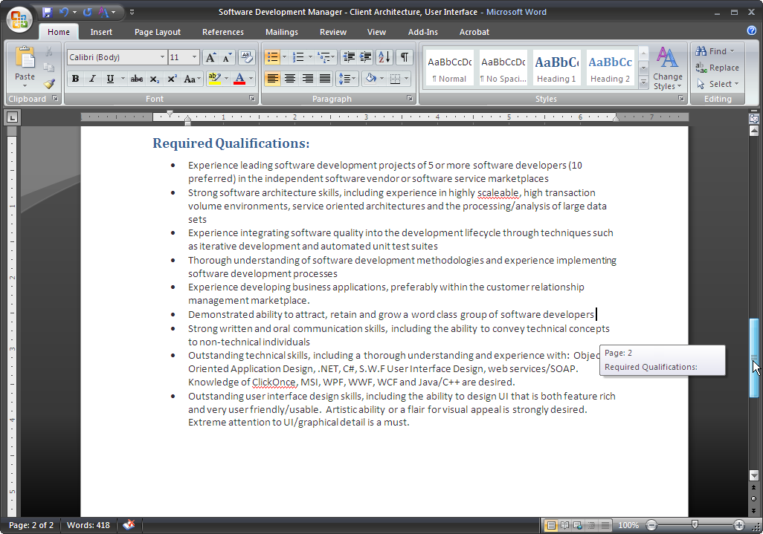
Annotated Scrollbar

Slide 33
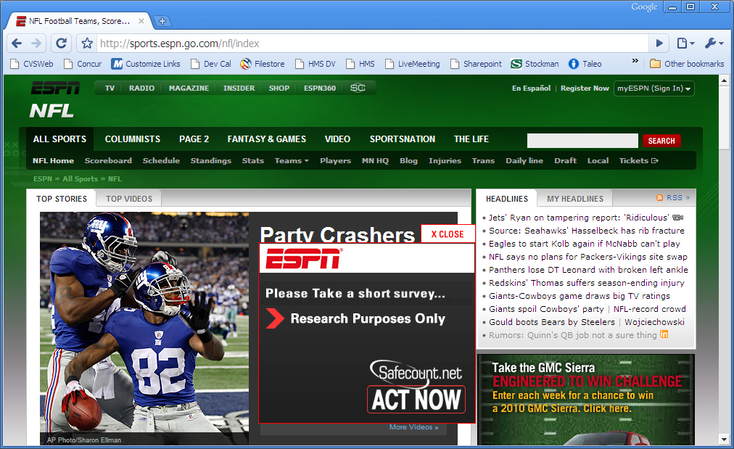
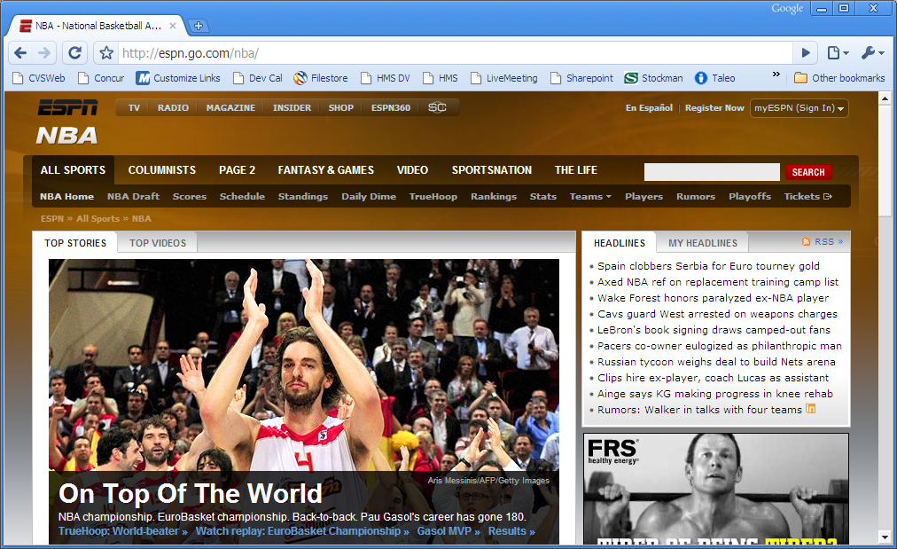
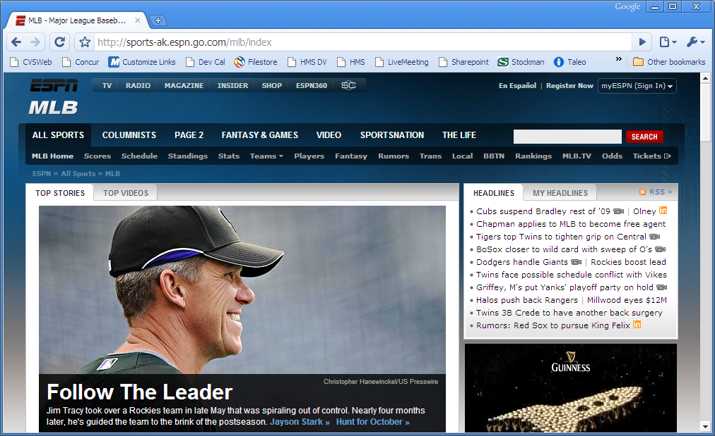
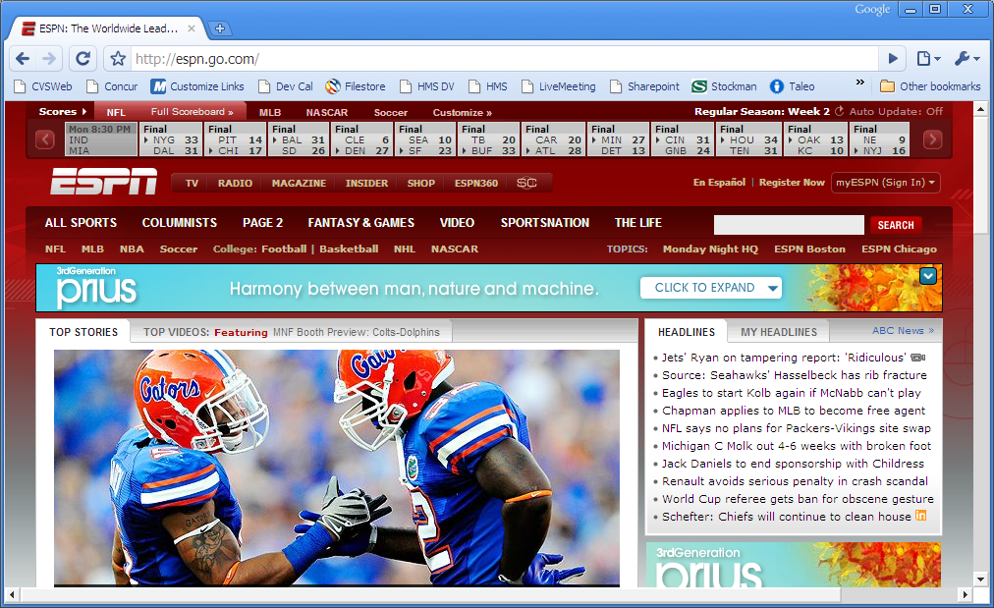
Color Coded Sections
Use of color to identify sequence or location of current page in an application

Slide 34
Misc

Slide 35
Animated Transition
Use of animation to assist a user in understanding page transition
Typically used when navigation path is a large leap or complex path for the user to comprehend

Slide 36
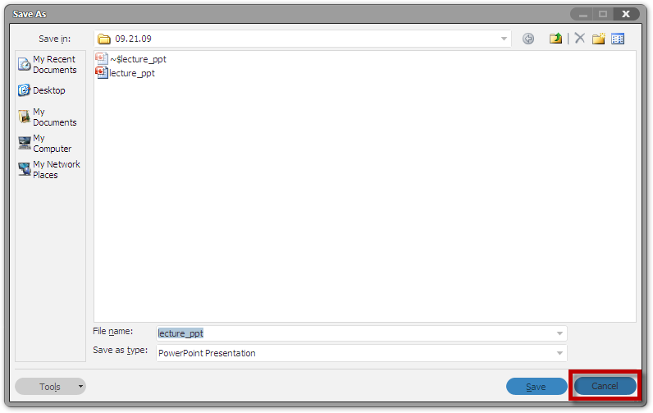
Escape Hatch
Pages with limited navigation options/actions should have an action that aborts the current operation and returns to a known place

